Slide 1
Hierarchical Retrieval

Slide 2
Objectives
After completing this lesson, you should be able to do the following:
  Interpret the concept of a hierarchical query
  Create a tree-structured report
  Format hierarchical data
  Exclude branches from the tree structure
Notes:
Oracle Database 10g: SQL Fundamentals II 7 - <number>
Objectives
In this lesson, you learn how to use hierarchical queries to create tree-structured reports.

Slide 3
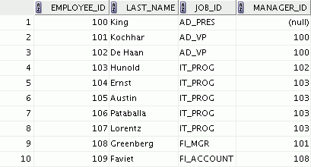
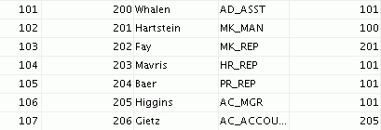
Sample Data from the EMPLOYEES Table
…
Notes:
Oracle Database 10g: SQL Fundamentals II 7 - <number>
Sample Data from the EMPLOYEES Table
Using hierarchical queries, you can retrieve data based on a natural hierarchical relationship between rows in a table. A relational database does not store records in a hierarchical way. However, where a hierarchical relationship exists between the rows of a single table, a process called tree walking enables the hierarchy to be constructed. A hierarchical query is a method of reporting, with the branches of a tree in a specific order.
Imagine a family tree with the eldest members of the family found close to the base or trunk of the tree and the youngest members representing branches of the tree. Branches can have their own branches, and so on.
A hierarchical query is possible when a relationship exists between rows in a table. For example, in the slide, you see that employees with the job IDs of AD_VP, ST_MAN, SA_MAN, and MK_MAN report directly to the president of the company. You know this because the MANAGER_ID column of these records contains the employee ID 100, which belongs to the president (AD_PRES).
Note: Hierarchical trees are used in various fields such as human genealogy (family trees), livestock (breeding purposes), corporate management (management hierarchies), manufacturing (product assembly), evolutionary research (species development), and scientific research.

Slide 4
Natural Tree Structure
EMPLOYEE_ID = 100 (Parent)
King
MANAGER_ID = 100 (Child)
Kochhar
De Haan
Mourgos
Zlotkey
Hartstein
Whalen
Higgins
Hunold
Rajs
Davies
Matos
Vargas
Fay
Gietz
Ernst
Lorentz
Abel
Taylor
Grant
Notes:
Oracle Database 10g: SQL Fundamentals II 7 - <number>
Natural Tree Structure
The EMPLOYEES table has a tree structure representing the management reporting line. The hierarchy can be created by looking at the relationship between equivalent values in the EMPLOYEE_ID and MANAGER_ID columns. This relationship can be exploited by joining the table to itself. The MANAGER_ID column contains the employee number of the employee’s manager.
The parent-child relationship of a tree structure enables you to control:
The direction in which the hierarchy is walked
The starting point inside the hierarchy
Note: The slide displays an inverted tree structure of the management hierarchy of the employees in the EMPLOYEES table.

Slide 5
Hierarchical Queries
SELECT [LEVEL], column, expr...
FROM table
[WHERE condition(s)]
[START WITH condition(s)]
[CONNECT BY PRIOR condition(s)] ;
WHERE condition:
expr comparison_operator expr
Notes:
Oracle Database 10g: SQL Fundamentals II 7 - <number>
Keywords and Clauses
Hierarchical queries can be identified by the presence of the CONNECT BY and START WITH clauses.
In the syntax:
SELECT Is the standard SELECT clause
LEVEL For each row returned by a hierarchical query, the LEVEL pseudocolumn returns 1 for a root row, 2 for a child of a root, and so on.
FROM table Specifies the table, view, or snapshot containing the columns. You can select from only one table.
WHERE Restricts the rows returned by the query without affecting other rows of the hierarchy
condition Is a comparison with expressions
START WITH Specifies the root rows of the hierarchy (where to start). This clause is required for a true hierarchical query.
CONNECT BY Specifies the columns in which the relationship between parent and child PRIOR rows exist. This clause is required for a hierarchical query.
The SELECT statement cannot contain a join or query from a view that contains a join.

